Slide 1

Row Major and Column Major Order Representation of Arrays; Sparse Matrices and their representation
Data Structure | Introduction to Data Structure
Course: Data Structure | Chapter: Introduction to Data Structure | Program: Bachelor of Engineering
DISCOVER · LEARN · EMPOWER
Notes:
Welcome everyone to today's lecture on Data Structures. We will focus specifically on how arrays are stored in memory and how we handle sparse matrices efficiently. This foundational knowledge is crucial for understanding algorithm complexity later. Let us begin our journey into memory representation.

Slide 2
Course Outcomes
SLIDE 2 / 10
Course Outcome
CO | BT LEVEL | DESCRIPTION
CO1 | BT1 | Understand and apply basic data structures, algorithms, complexity analysis, ADTs, arrays and linked lists.
CO2 | BT2 | Apply and implement stacks and queues in problem-solving.
CO3 | BT3 | Analyse and apply searching, sorting, and hashing techniques.
CO4 | BT4 | Construct and apply tree structures and traversal techniques.
CO5 | BT5 | Represent and solve graph problems using DFS, BFS, and graph algorithms.
Chandigarh University
2 / 10
Notes:
Today's lecture directly addresses CO1 by teaching you how arrays and sparse matrices are implemented as basic data structures. We will also touch upon CO5 because sparse matrices are often used to represent adjacency matrices in graph algorithms. Understanding these representations is key to solving graph problems efficiently. Please note these outcomes as we progress through the slides.

Slide 3
Learning Objectives
SLIDE 3 / 10
Learning Outcomes
1
Define the concept of array representation in computer memory.
2
Differentiate between Row Major and Column Major ordering methods.
3
Calculate memory addresses using the Row Major formula for 2D arrays.
4
Calculate memory addresses using the Column Major formula for 2D arrays.
5
Identify sparse matrices and explain their efficient storage requirements.
Chandigarh University
3 / 10
Notes:
By the end of this session, you will be able to define how arrays live in memory. You will learn to distinguish between the two main storage orders used in C and C++. We will work through formulas to calculate specific memory addresses. Finally, you will understand why sparse matrices need special handling to save space.

Slide 4
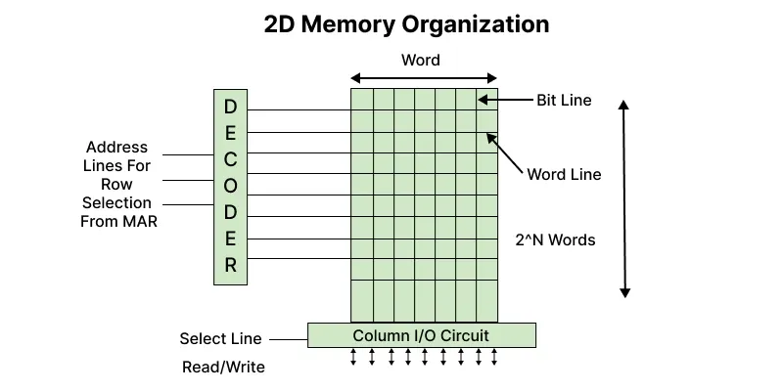
Lecture
SLIDE 4 / 10
Array Memory Representation Basics
1
Arrays store elements in contiguous memory locations for fast access.
2
A 2D array is logically a grid but physically a linear sequence.
3
The base address is the memory location of the first element A[0][0].
4
Element size determines the offset calculation for any specific index.
5
The total size depends on the number of rows and columns.
2D and 2.5D Memory organization - GeeksforGeeks
Chandigarh University
4 / 10
Notes:
Think of a 2D array as a table of numbers, but computers store it as a single long line of memory. The first element, A[0][0], sits at the base address. Every subsequent element follows immediately after the previous one. The size of each element, like 4 bytes for an integer, is critical for calculating where any specific data lives.

Slide 5
Lecture
SLIDE 5 / 10
Row Major Order Representation
GOVERNING EQUATION
The formula for address is: Loc(A[i][j]) = Base + (i × N + j) × Size
1
Row Major stores all elements of the first row before the second.
2
Elements are stored sequentially row by row until the matrix ends.
3
N represents the total number of columns in the array.
4
This is the default storage order for C and C++ languages.
Chandigarh University
5 / 10
Notes:
In Row Major order, the computer fills the first row completely before moving to the second. Imagine filling a spreadsheet from left to right, top to bottom. The formula uses the number of columns to skip past entire rows. This is the standard method used in C and C++ programming languages.

Slide 6
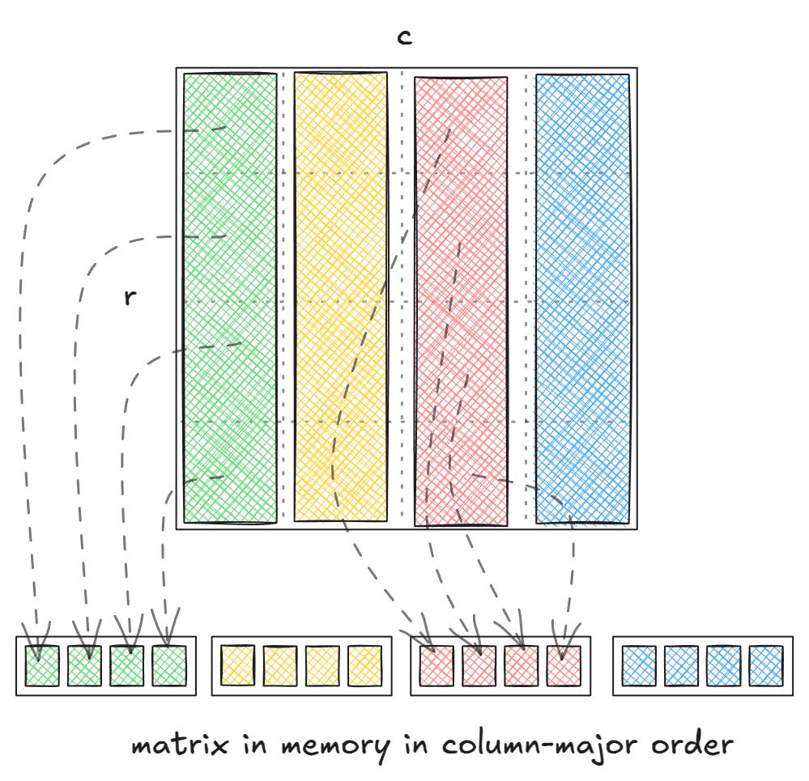
Lecture
SLIDE 6 / 10
Column Major Order Representation
GOVERNING EQUATION
The formula for address is: Loc(A[i][j]) = Base + (j × M + i) × Size
1
Column Major stores all elements of the first column before the second.
2
Elements are stored sequentially column by column until the matrix ends.
3
M represents the total number of rows in the array.
4
This order is commonly used in Fortran and MATLAB languages.
Source: substackcdn.com
Chandigarh University
6 / 10
Notes:
In Column Major order, the computer fills the first column completely before moving to the second. It is like reading a book column by column instead of line by line. The formula uses the number of rows to skip past entire columns. This method is standard in languages like Fortran and MATLAB.

Slide 7
Worked Example
SLIDE 7 / 10
Row Major Calculation
GOVERNING EQUATION
Given A[3][4] with Base=1000 and Size=4 bytes
CALCULATION
1000 + (2 × 4 + 1) × 4 = 1000 + 9 × 4.
RESULT
Address of A[2][1] is 1036.
• Find address of A[2][1] using Row Major formula.
• This shows how skipping rows adds significant offset to the base.
Chandigarh University
7 / 10
Notes:
Let's calculate the address of element A[2][1] in a 3x4 array starting at 1000. We multiply the row index 2 by the column count 4, then add the column index 1 to get 9. Multiplying this by the size 4 gives an offset of 36. Adding this to the base 1000 gives us the final address 1036.

Slide 8
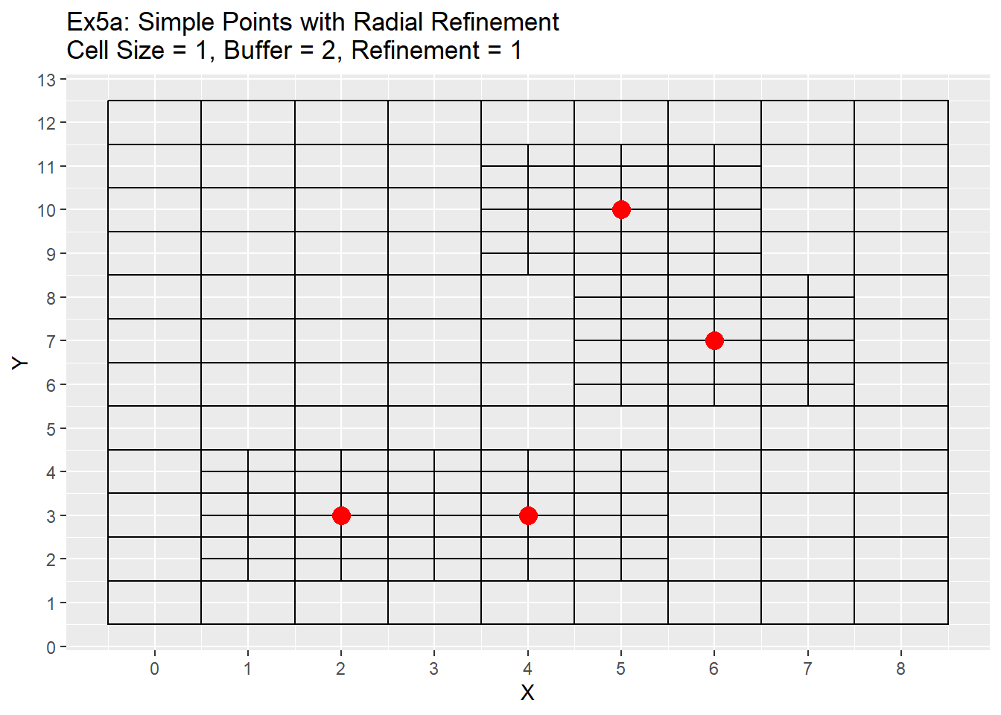
Lecture
SLIDE 8 / 10
Sparse Matrices Definition
1
A sparse matrix contains a large number of zero elements.
2
Storing all zeros wastes significant memory space inefficiently.
3
The density is low, meaning non-zero elements are rare.
4
Standard array representation is unsuitable for very large sparse matrices.
5
Specialized representations are required to optimize storage and processing.
Source: bkonetchy.com
Chandigarh University
8 / 10
Notes:
A sparse matrix is one where most of the elements are zero. If you store a 1000x1000 matrix with only ten non-zero numbers using a standard array, you waste 99.9% of the memory. This inefficiency is unacceptable for large datasets in scientific computing. We need a smarter way to store only the useful data.

Slide 9
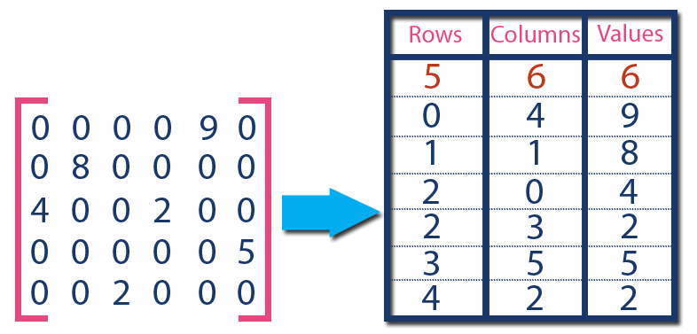
Lecture
SLIDE 9 / 10
Sparse Matrix Representation Methods
EXAMPLE
A 5x5 matrix with 5 non-zeros uses minimal storage.
• Three-Array Representation stores row indices, column indices, and values.
• Each non-zero element is stored as a triplet (row, col, value).
• A header row stores the total rows, columns, and non-zero count.
• This reduces space from O(M×N) to O(3×NonZeroElements).
Source: www.btechsmartclass.com
Chandigarh University
9 / 10
Notes:
We can represent a sparse matrix using three parallel arrays or a list of triplets. Each triplet records the row number, column number, and the actual value of a non-zero element. A header tells us the matrix dimensions and how many non-zero items exist. This method drastically reduces memory usage compared to storing every single zero.

Slide 10
Lecture
SLIDE 10 / 10
References
DATA STRUCTURES
A Pseudocode Approach with C — Gilberg, Forouzan
• Data Structures — Lipschutz
• Data Structure Using C — AK Sharma
• C and Data structure — P. S. Deshpandey
Chandigarh University
10 / 10
Notes:
These four textbooks provide comprehensive coverage of the topics discussed today. Gilberg and Forouzan offer excellent pseudocode and C implementations. Lipschutz provides a strong theoretical foundation for data structures. Sharma and Deshpandey offer practical C-based examples for arrays and sparse matrices. Please refer to these books for further study.

